Slide 1
Getting Started with Apptainer on Hoffman2
Similar to Docker, but not the same

Slide 2
Setting Up
Login to the cluster
qrsh -l h_rt=3:00:00,h_data=4G -pe shared 2
Wait a minute or two for this
cp /u/scratch/m/mweinste/ws2.tar.gz $SCRATCH
cd $SCRATCH
tar –xvf ws2.tar.gz
Bunch of text flies across the screen

Slide 3
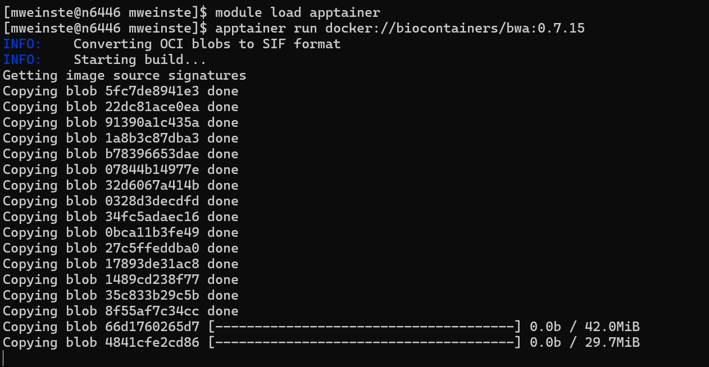
Prepare to run our BWA container

Slide 4
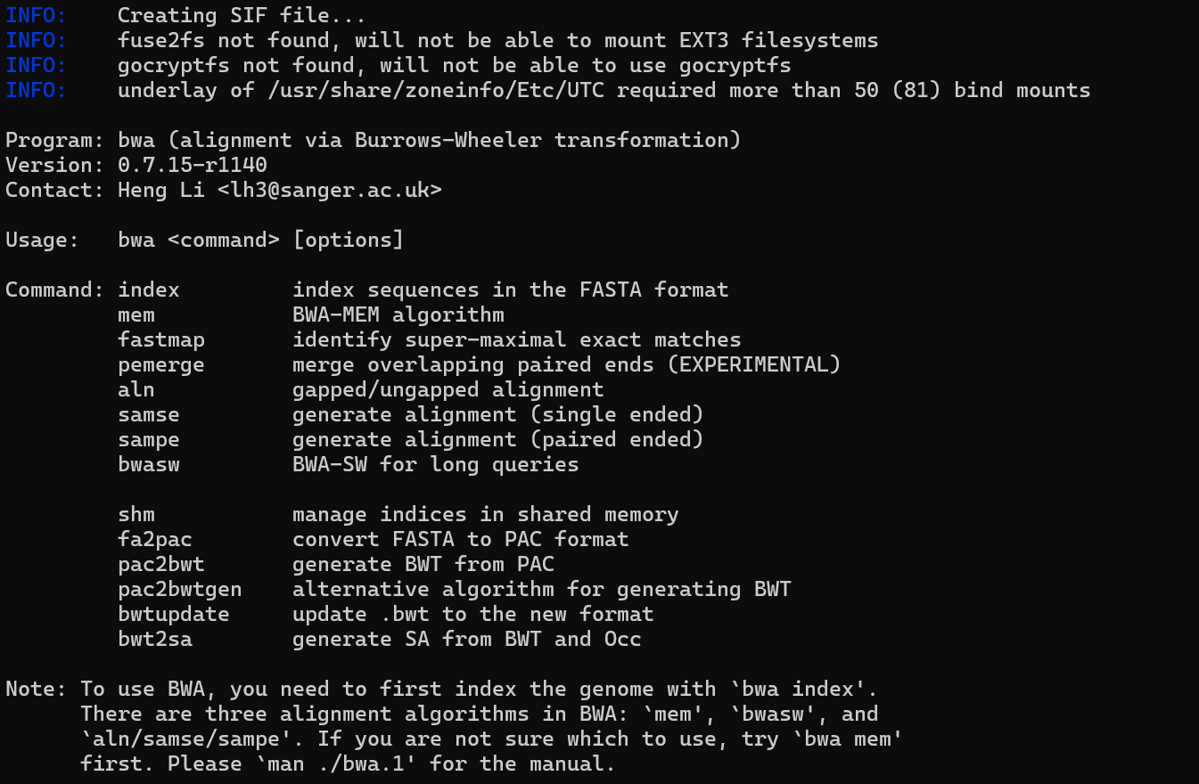
Confirming a working BWA

Slide 5
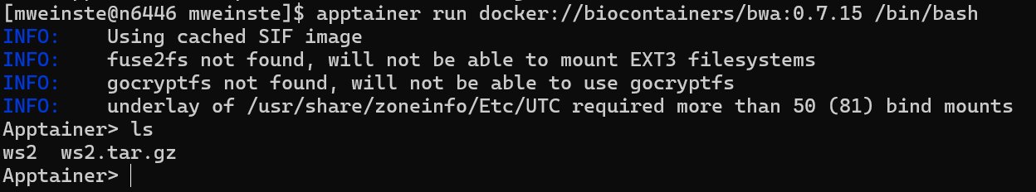
Getting a shell in our container
Note that we did not have to explicitly mount our current working directory into the container
It also mounted in our home folder, which can be accessed using the ~ shortcut

Slide 6
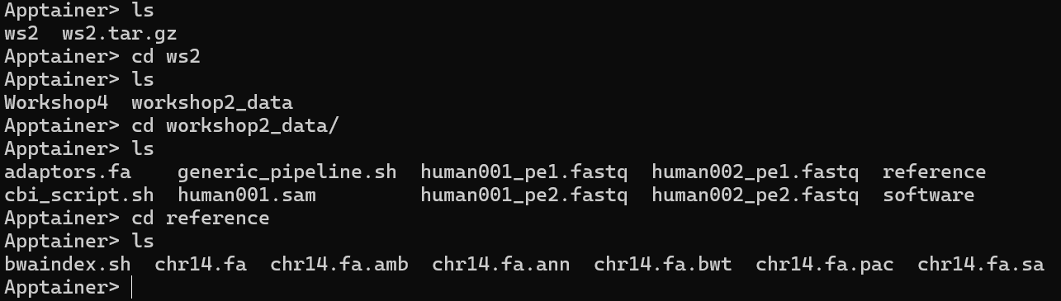
Going over the file structure of our data

Slide 7
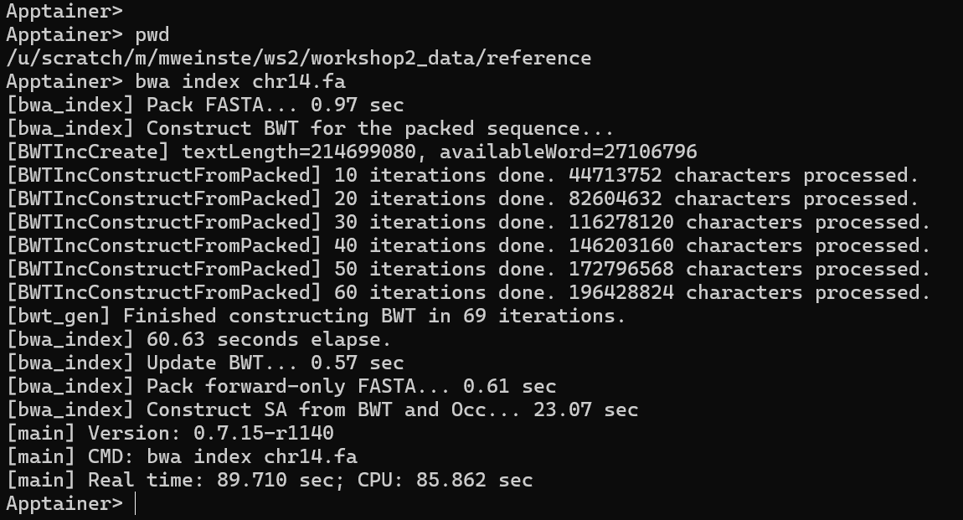
Indexing our reference genome

Slide 8
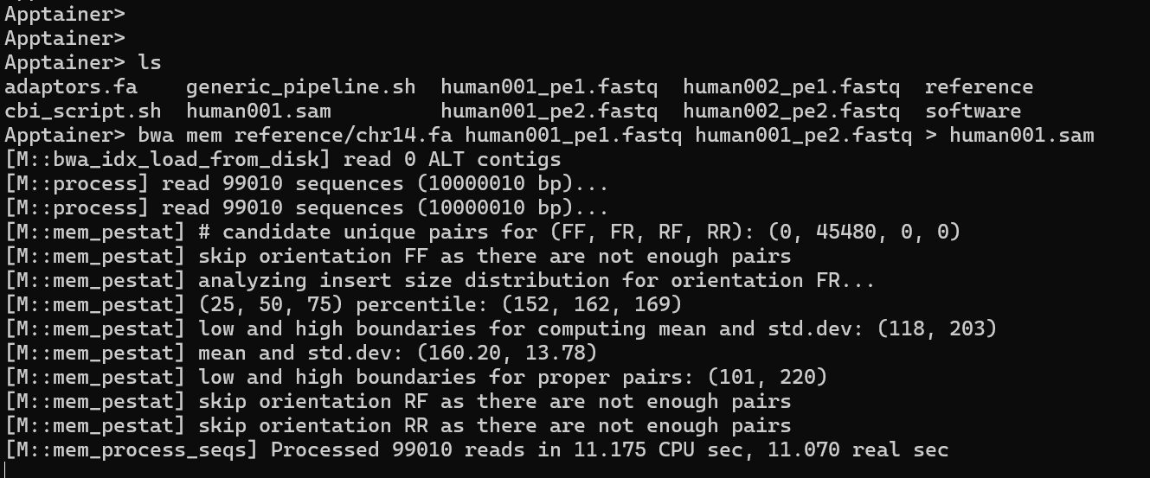
Starting our BWA alignment

Slide 9
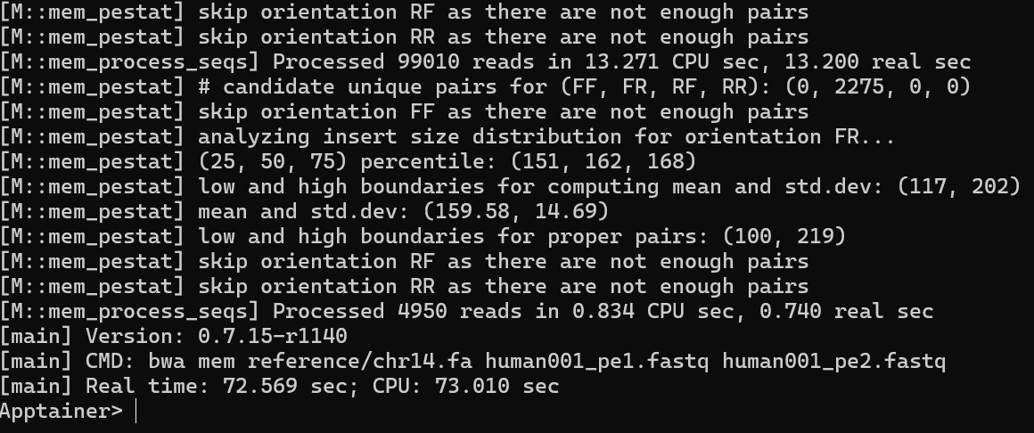
Completing our BWA alignment

Slide 10
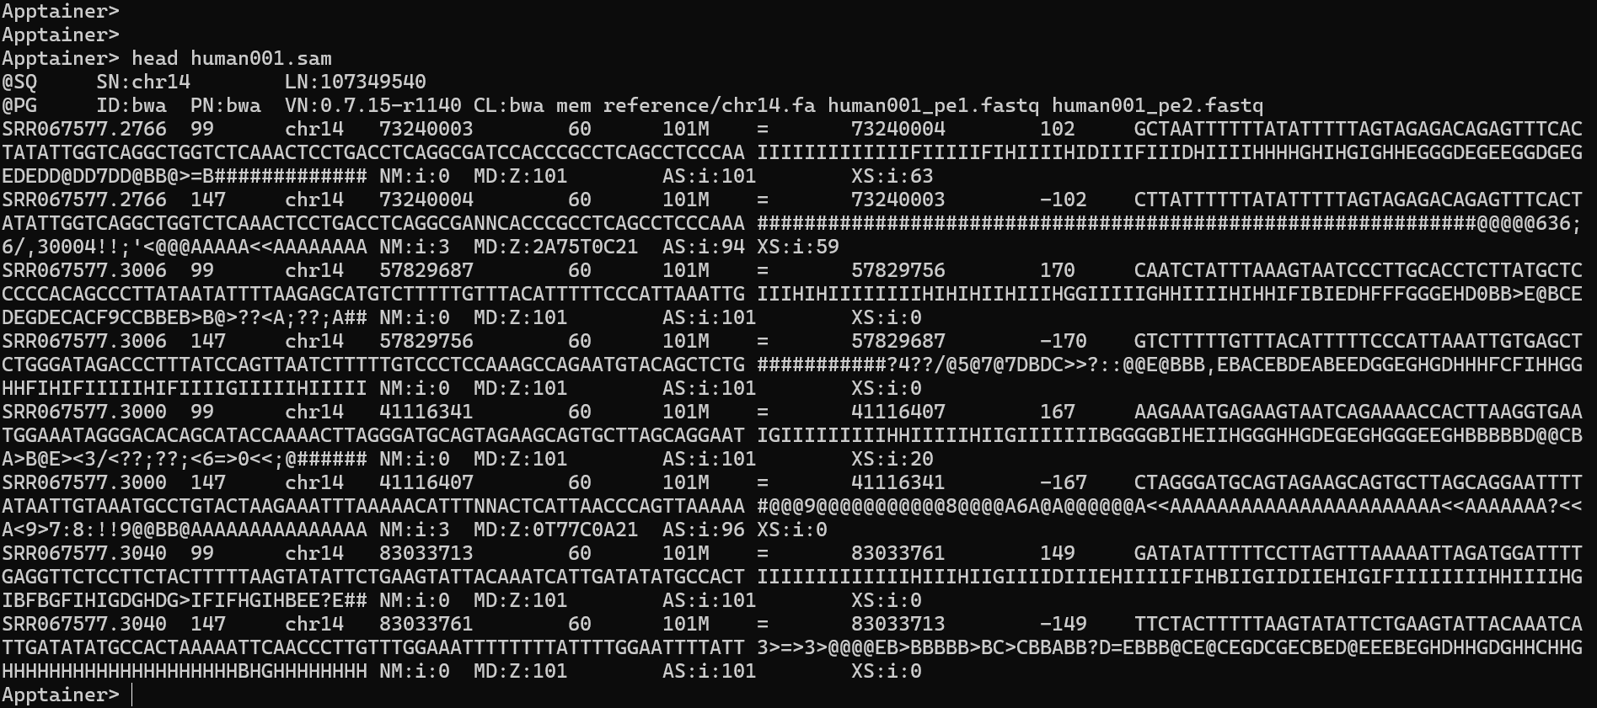
Checking our output

Slide 11
Finishing up
The command exit will get you out of the Apptainer environment
You should be back in your scratch folder
You can go into the folder containing the read data and see that everything we created in the Apptainer environment is still present in the host environment

